Slide 1
Escape Room Sleuth Employment System
By: Joshua Bradley, Kaden Trousdale, Daniel Wells, John Weatherford

Slide 2


Problem Statement
High labor costs: 1 room host per room
Inefficient clue delivery (manual process via Google Docs)
Need to reduce costs and improve customer experience

Slide 3
Feasibility Study
Economic Feasibility: Reduce labor from 5 to 2 staff, strong ROI
Technical Feasibility: Achievable with current tech (Python, mobile apps)
Operational Feasibility: Easier staff scheduling and operation
Legal Feasibility: No legal barriers
Time Feasibility: Achievable within semester

Slide 4
Requirements Overview
Automated clue delivery based on room progress
Mobile app for remote monitoring
Centralized dashboard for employees
Compatibility with Android/iOS

Slide 5
Functional Requirements
Monitor group progress
Timed and manual clue distribution
Automated timer with customizable start/stop
Room ambiance control
Employee authentication system

Slide 6
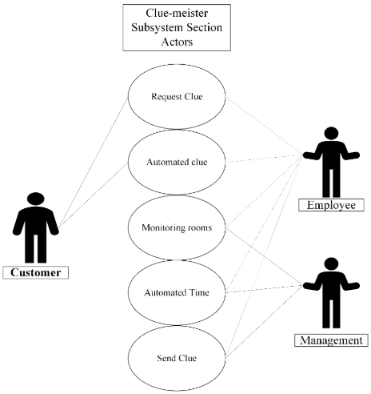
Operational & Mobile Requirements
System cost: <$12K installation, <$4K development
Mobile App:
Android 11+ / iOS 12+
Location-based access control
ADA & WCAG compliance

Slide 7
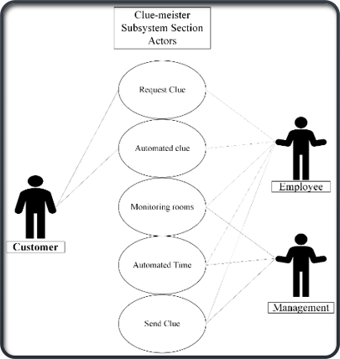
USe case diagram & Actors
Actors: Customer, Employee, Management
Functions:
Customer: Requests clue
Employee: Approves/sends clues, monitors rooms
Management: Monitors system, overrides special clues

Slide 8
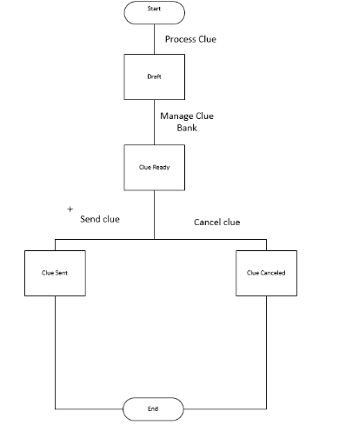
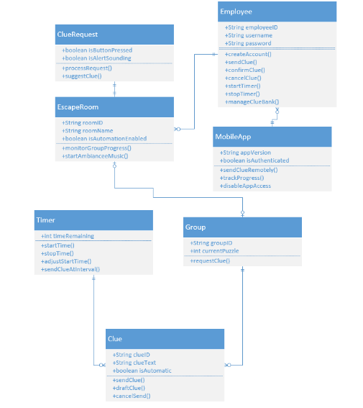
Preliminary Design Overview
Three Subsystems:
Clue-Meister (clue delivery)
Cloud Database (storage)
Mobile App (remote operations)

Slide 9
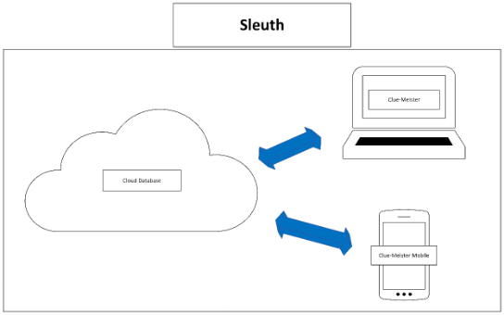
System of interest diagram
Central system managing:
Flowchart-based clue progression
Room timers
Database interaction
Mobile synchronization

Slide 10

Environment and components
Hardware: Company-owned PCs & Monitors
Software: Python backend, Cloud storage
Displays: Room monitors showing time, clues
Mobile apps connecting through cloud database

Slide 11
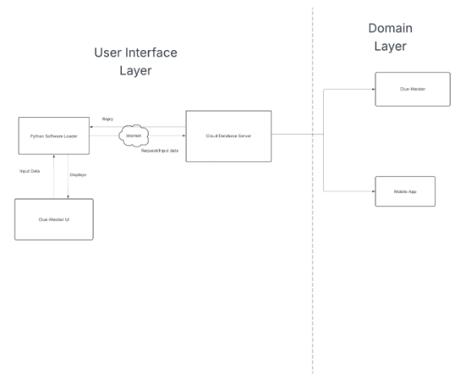
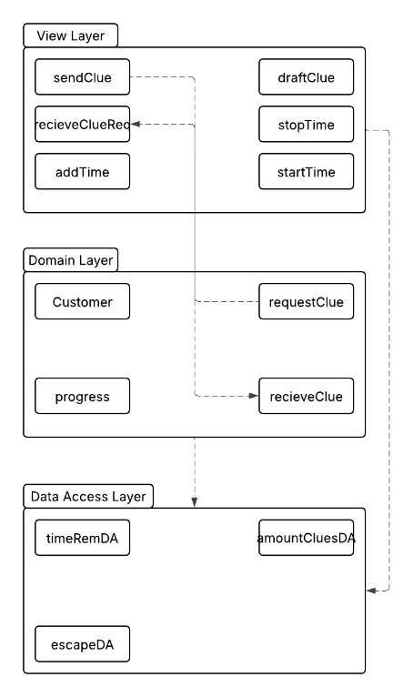
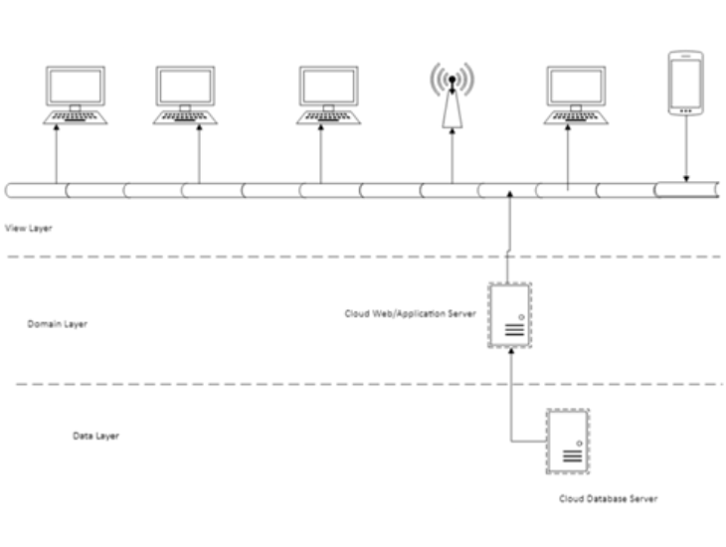
Design Diagrams
Deployment Diagram: Three-tier architecture
Package Diagram: Logical organization of subsystems
Component Diagram: Clue delivery, monitoring, database

Slide 12
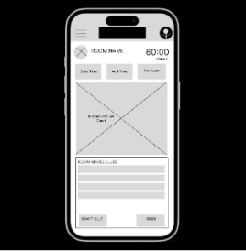
UI & DATABASE OVErview
Low-Fidelity UI:
Homepage, Room Monitoring, Profile Settings
Database:
Employee data, Clue bank, Room reports
Flowchart-driven UI for dynamic clue delivery

Slide 13
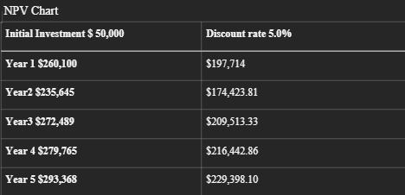
Project Financials
Initial Investment: $50,000
ROI: $132,174 after 5 years
Payback Period: 2-3 years
Annual cashflow return: 35%

Slide 14
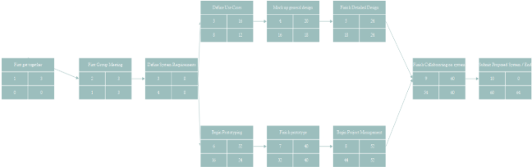
PERT and CPM Charts
PERT: Identified task durations
CPM: Critical path management
Project duration aligns with course timeline

Slide 15
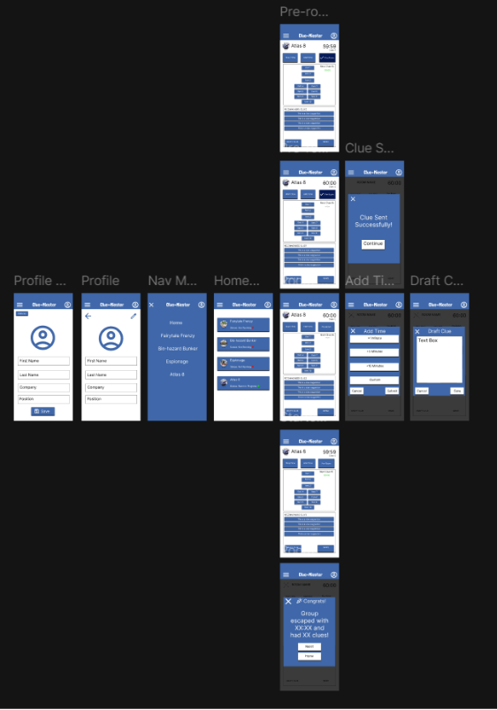
Working Prototype Overview
Homepage with quick room access
Room-specific dashboards (timer, clue control)
Profile Management
Draft, send, and monitor clues
Flowchart-driven room progress tracking

Slide 16
THANK YOU!

